Slide 1
With Python

Slide 2
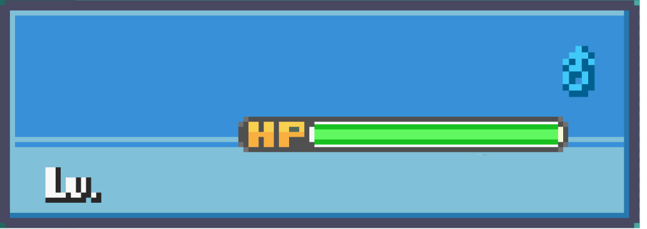

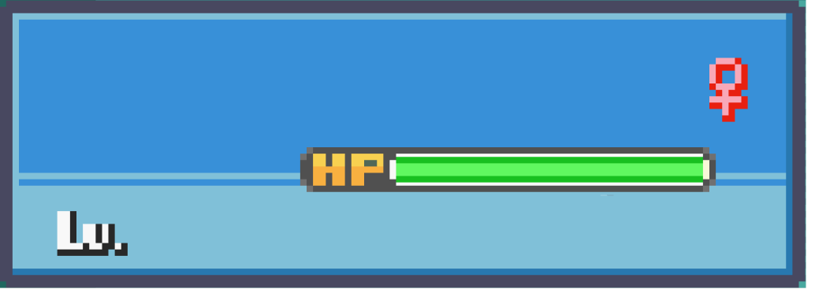
Team Members
Pranav H
Pragathi P
18
PES1UG23CS433
19
PES1UG23CS424
Noel Jose
Pranav R
18
PES1UG23AM197
18
PES1UG23CS435
NEXT

Slide 3
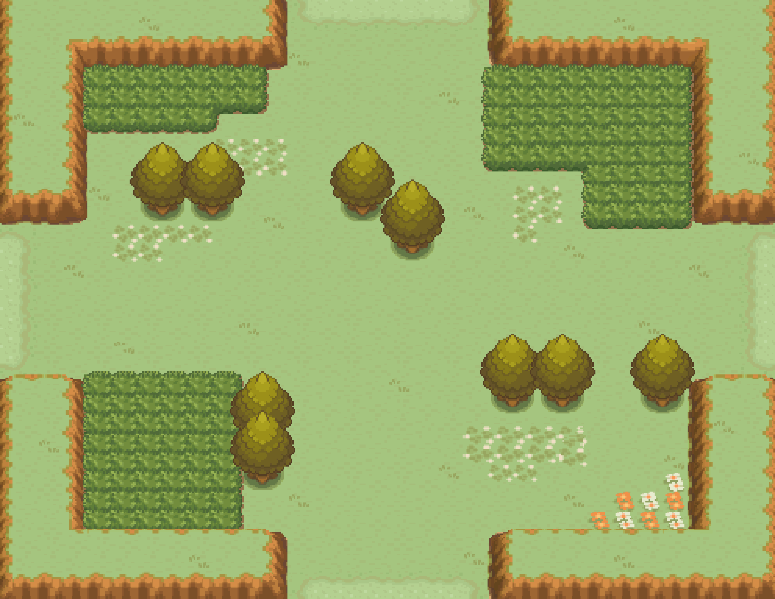






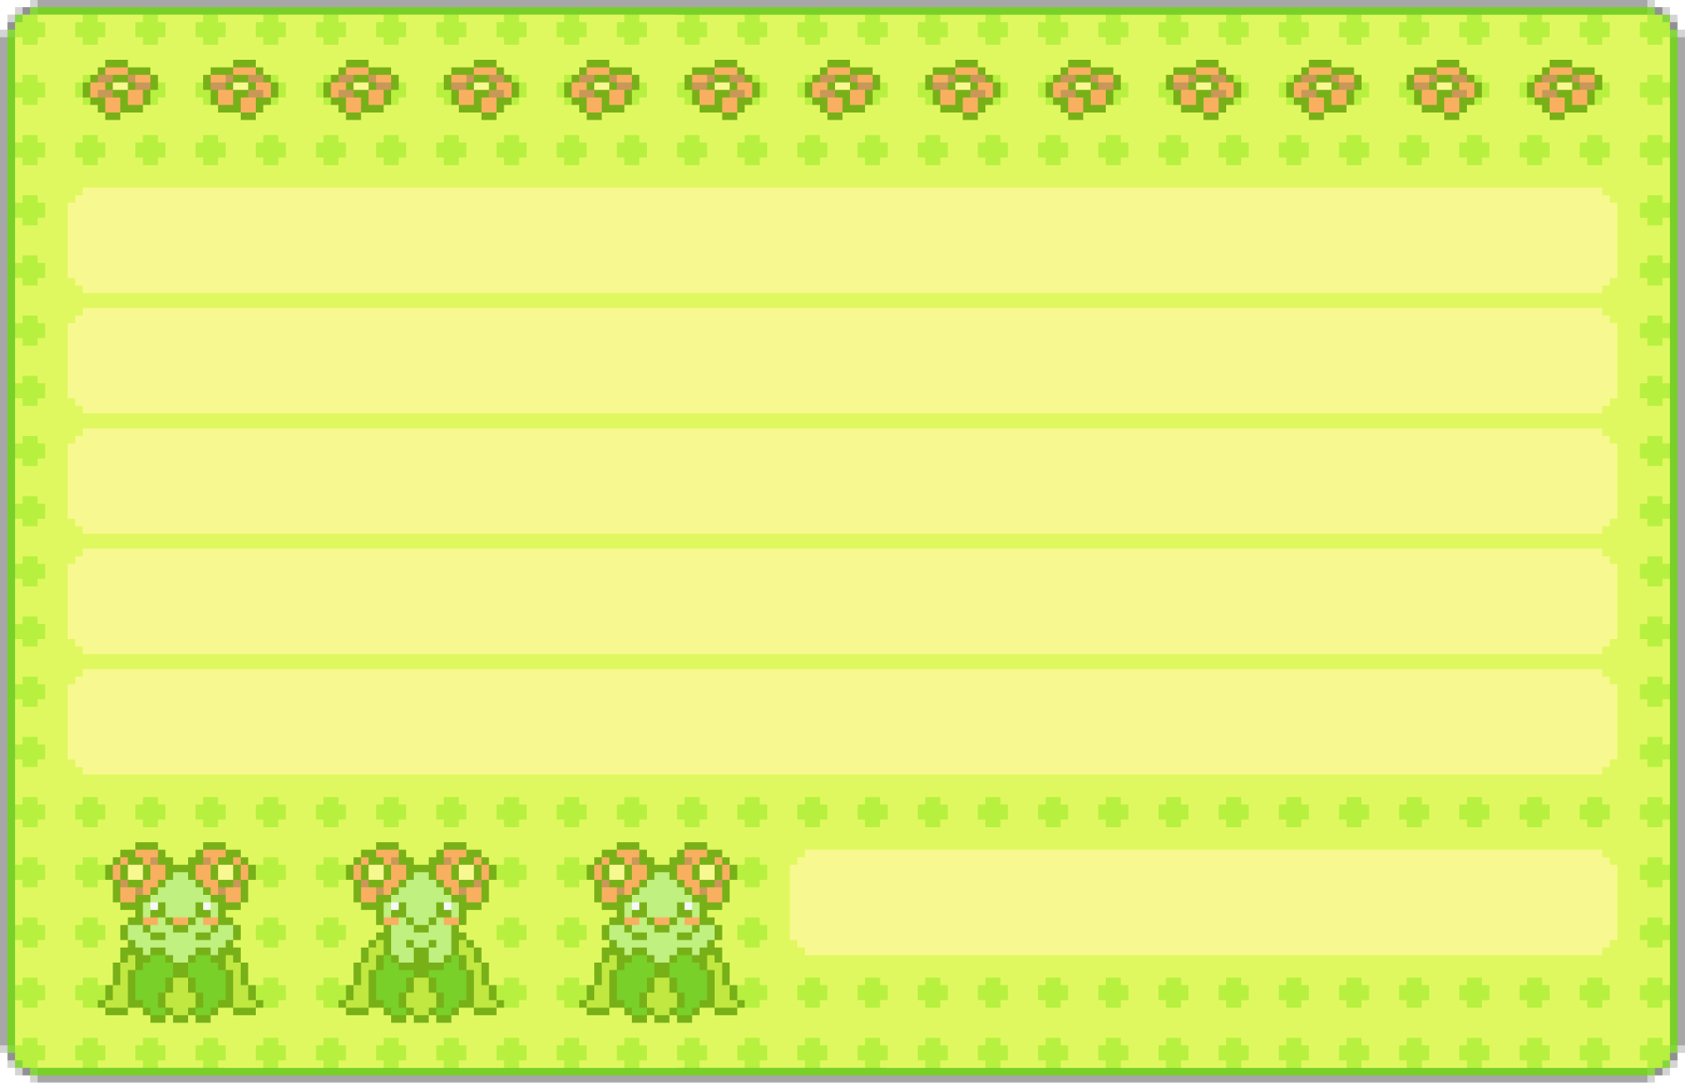
END USERS
Game Enthusiasts
Teenagers
Content Creators
Game Developers
Pokémon Fans
PROBLEM STATEMENT To create a turn based RPG game inspired by Pokémon using only Python and Python Libraries.

Slide 4



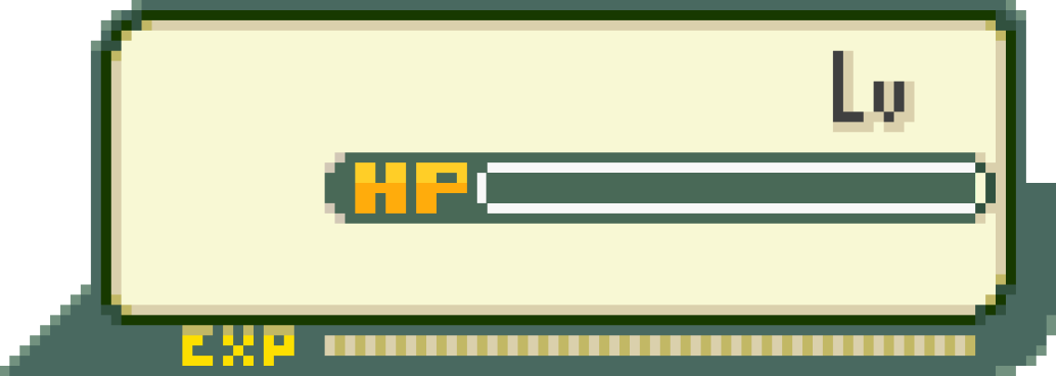
Functionalities Planned
Singleplayer
3
Multiplayer
6
50/50
Simulated Battles
Fun Experience
User Friendly UI
QOL Features

Slide 5
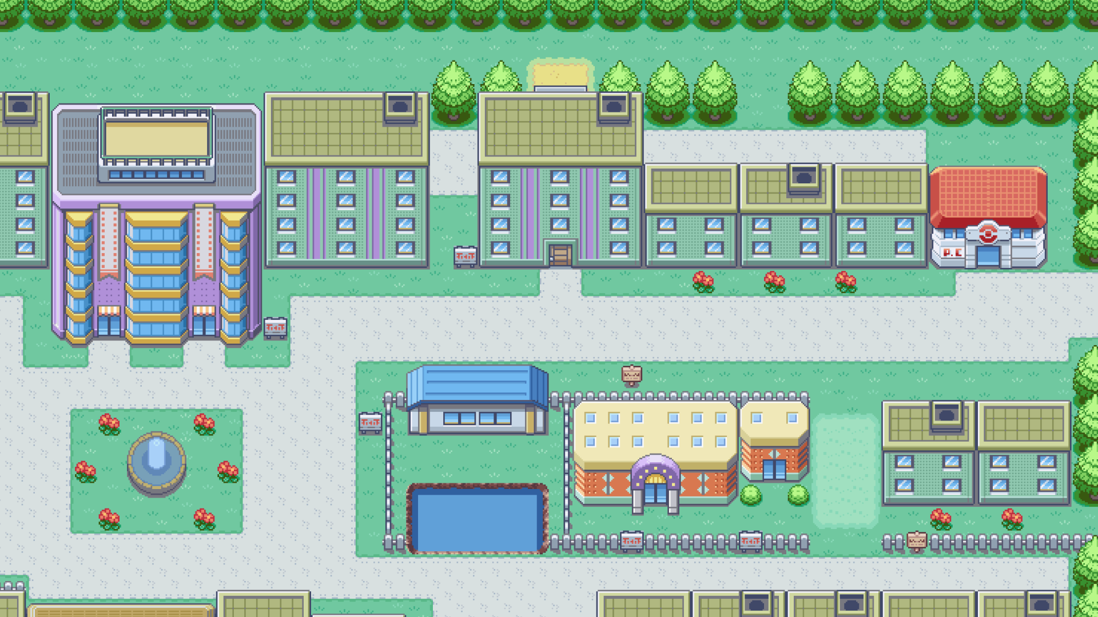
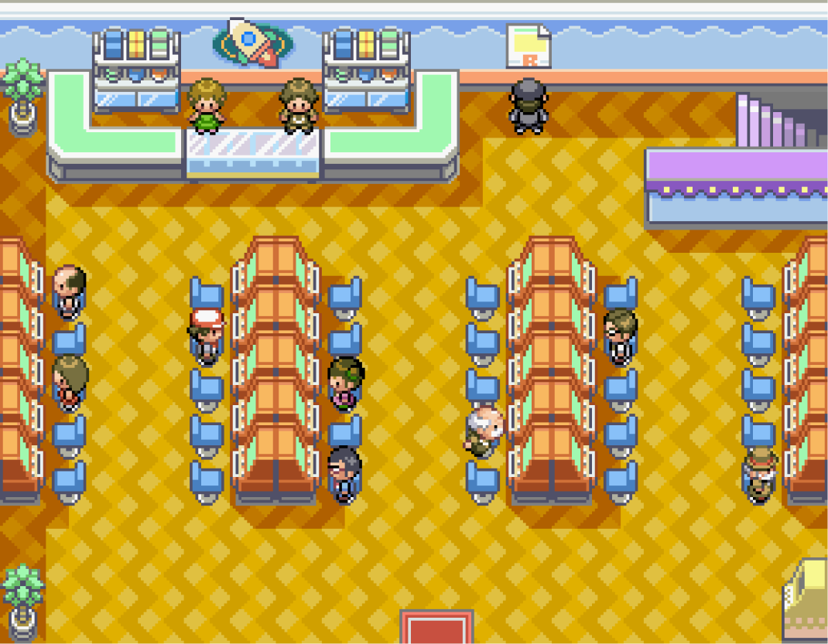



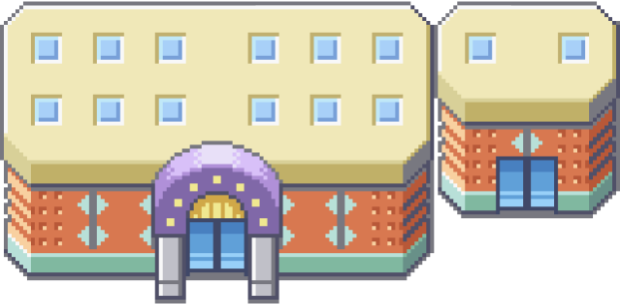
DIVISION OF WORK
Pranav H: Logic
Noel J: Logic, Design and GUI
Pranav R: Logic
Pragathi P: Graphic Design

